Slide 1

21AIE495 Project – Approval Presentation Team ID: 21UG178 Panel No.: 01
Modelling Human Visuomotor Coordination in Dual-Tasking using Deep Inverse Reinforcement Learning
Sr. No | Reg. No | Name of the Student | Branch
1 | BL.EN.U4AIE21083 | Muppavarapu Sri Harshini | AIE
2 | BL.EN.U4AIE21105 | Pranav H | AIE
3 | BL.EN.U4AIE21109 | Rachuri Tarun | AIE
Project Guide: Dr. Nippun Kumar A.A.

Slide 2
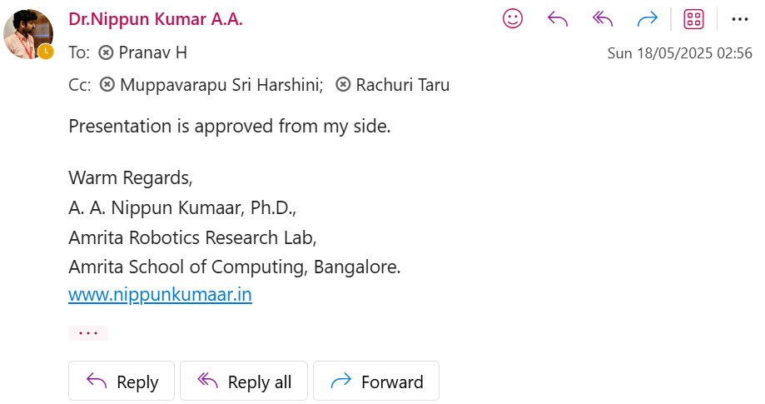
Guide Approval

Slide 3
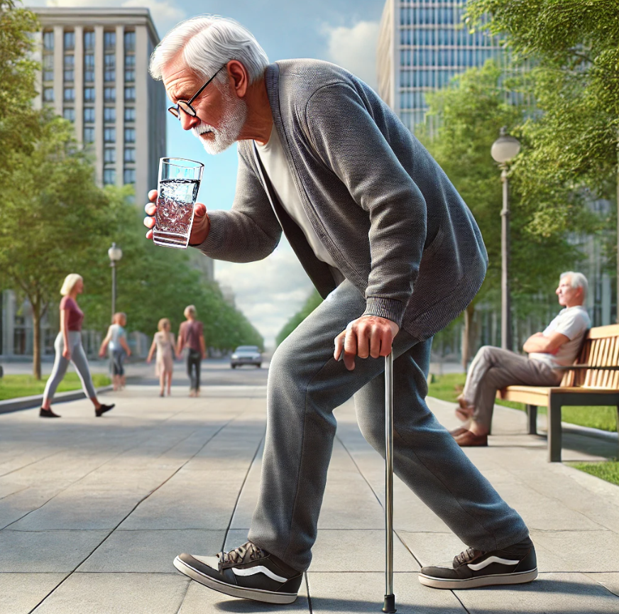
Dual-Task Learning
"An Old Adult struggles to walk while holding a glass of water. Their brain must balance movement and grip control simultaneously. This is dual-task motor learning how we manage multiple actions at once."

Slide 4
What is dual tasking…?
As seen in the image, the person is walking while holding a glass of water, requiring the brain to balance movement and grip control simultaneously.
Dual-task learning is the brain’s ability to manage two actions at once without losing efficiency.
The brain continuously shifts attention between tasks, affecting reaction time, memory, and decision-making.
This concept applies to real-world situations like driving while talking, playing sports, or working on multiple tasks.
Our project focuses on training AI to understand dual-task performance, enabling machines to model human-like multitasking.

Slide 5
Deep Inverse Reinforcement Learning
Deep Inverse Reinforcement Learning (DIRL) combines traditional Inverse Reinforcement Learning (IRL) with deep learning techniques to allow an agent to learn a reward function based on expert behavior rather than predefined rewards.
The agent observes expert demonstrations and uses neural networks to infer a reward function, which helps the agent understand the underlying motivations for the expert’s actions.
After inferring the reward function, the agent can then apply reinforcement learning algorithms to optimize its behavior and improve decision-making in complex environments.

Slide 6
Deep Inverse Reinforcement Learning
In dual motor tasks, DIRL helps agents learn complex coordination and cognitive decision-making by observing expert demonstrations. It enables agents to develop cognitive skills such as task prioritization and adjustment in real-time, improving performance with limited feedback.
RL can be applied in this like:
DIRL-Based Agent Learning
Cognitive Skill Enhancement
Dual Motor Task Optimization

Slide 7
Objective
The objective of this project is to apply Deep Inverse Reinforcement Learning (DIRL) to model human strategies for performing dual tasks that simultaneously challenge motor and cognitive skills.
This project aims to investigate the internal mechanisms humans adopt while dual-tasking to achieve optimized performance under cognitive and motor-demanding conditions.
Furthermore, understanding this model is crucial to analyzing how older adults approach dual-tasking while walking compared to younger individuals. Any deviations between these groups will provide insights for scientifically guided interventions to enhance dual-tasking abilities in older adults.

Slide 8
Major Project Details
Problem Statement
Training AI to manage cognitive and motor functions simultaneously is challenging due to inefficient learning methods. Traditional Reinforcement Learning (RL) relies on random exploration, leading to slow adaptation, poor sample efficiency, and an inability to prioritize key actions, making it unsuitable for multitasking. This project utilizes Deep Inverse Reinforcement Learning (DIRL) to learn from expert demonstrations, enabling AI to prioritize critical actions, optimize performance, and adapt effectively in complex environments. The current focus is on analyzing how an ideal human performs dual-task learning using DIRL.

Slide 9
Approach to Solve the Problem
We adopted a multi-phased approach to address our problem statement:
Phase 1: Research – Investigated and analysed existing solutions relevant to our problem statement, and the gaps in their research.
Phase 2: Pipeline Formation – Developed a working pipeline by continuously iterating and refining the DIRL pipeline using synthetic data.
Phase 3: Integration – Substituted synthetic data with real VICON Motion Capture Data to enhance realism and performance.

Slide 10
Research

Slide 11
Summary of Literature Survey
Performing dual motor tasks in VR led to more conservative gait patterns, with participants timing their throws to walking phases without compromising accuracy.
Gait changes correlated with cognitive test performance, suggesting potential applications for rehabilitation and cognitive-motor training.
Inverse Reinforcement Learning (IRL) techniques were used to learn expert locomotion strategies, improving bipedal walking on complex terrains through inferred reward functions.
A study on multiple sclerosis (MS) participants found greater declines in cognitive performance, walking speed, and gait stability under dual-task conditions, indicating attention deficits or working memory overload rather than disease severity as primary factors.

Slide 12
Literature Survey
S.No. | Authors name(s) | Full title of the paper with year | Inference from the paper | Open Problem
1 | Yogesh Singh, Antonio Prado, Dario Martelli, Fitsum E. Petros, Xupeng Ai, Sudipto Mukherjee | Dual-Motor-Task of Catching and Throwing a Ball During Overground Walking in Virtual Reality | The paper studies the impact of performing dual motor tasks in VR, revealing more conservative gait patterns while catching and throwing a ball. Participants managed the dual-task without compromising throwing accuracy, timing throws with their walking phases. Gait changes correlated well with cognitive test outcomes, offering insights for rehabilitation and motor-cognitive interactions in VR. | Participants maintained throwing accuracy with conservative gait patterns, timing throws with gait phases. Gait changes correlated with cognitive test results. An open problem involves developing adaptive algorithms that adjust task difficulty based on real-time cognitive load, aiming to enhance executive function and optimize rehabilitation outcomes.
12

Slide 13
Literature Survey
S.No. | Authors name(s) | Full title of the paper with year | Inference from the paper | Open Problem
2 | Yogesh Singh; Sunil K. Agrawal; Vineet Vashista | Throwing Strategy in a Dual-Motor-Task of Aiming at the Bullseye While Walking in Virtual Reality | The study used a dual-task paradigm in VR where participants performed a ball-throwing task while walking on a treadmill. They found that throwing accuracy was pre-determined by motor ability and that hit point variation in dual-tasking correlated with cognitive ability, reducing attentional load. The study achieved an optimized interaction of motor and cognitive skills, highlighting the potential for improving specific skills through dual-motor-task training. | An open problem is Develop adaptive algorithms that adjust dual-task difficulty in real-time based on cognitive load assessment, aiming to enhance executive function and optimize rehabilitation outcomes.
13

Slide 14
Literature Survey
S.No. | Authors name(s) | Full title of the paper with year | Inference from the paper | Open Problem
3 | Feiyang Wu; Zhaoyuan Gu; Hanran Wu; Anqi Wu; Ye Zhao | Infer and Adapt: Bipedal Locomotion Reward Learning from Demonstrations via Inverse Reinforcement Learning | The paper used Inverse Reinforcement Learning (IRL) techniques to learn expert reward functions for bipedal locomotion over complex terrains. It uncovered meaningful insights into expert locomotion strategies through nonlinear function approximation. The study achieved enhanced walking performance on unseen terrains by training bipedal locomotion policies with the inferred reward functions. | An open problem is enhancing the generalization of learned reward functions to handle various complex and dynamically changing terrains. Developing adaptive reward learning algorithms that integrate meta-learning with IRL can continuously adapt and refine reward functions based on new experiences, leveraging transfer learning to apply knowledge from known terrains to novel ones.
14

Slide 15
Literature Survey
S.No. | Authors name(s) | Full title of the paper with year | Inference from the paper | Open Problem
4 | Pei-Chun Kao , Michaela A. Pierro | Motor adaptation to cognitive challenges and walking perturbations in healthy young adults | The study examined how young adults adapt to concurrent cognitive challenges and walking perturbations. Gait adjustments during perturbed walking increased local instability and gait variability. Participants improved their mediolateral stability during specific cognitive tasks. Stride time variability showed less dual-task interference in unperturbed walking compared to perturbed walking. Participants prioritized walking stability under challenging conditions, but adjustments varied based on cognitive task type. | An open problem is to develop adaptive interventions that dynamically adjust cognitive, and motor task demands based on real-time performance metrics to improve walking stability under dual-task conditions. This could involve creating algorithms that tailor the difficulty of cognitive tasks and perturbations, optimizing the balance between cognitive load and motor control to enhance overall gait stability and minimize dual-task interference.
15

Slide 16
Literature Survey
S.No. | Authors name(s) | Full title of the paper with year | Inference from the paper | Open Problem
5 | F. Hamilton, L. Rochester, L. Paul, D. Rafferty, CP O'Leary, JJ Evans | Walking and talking: an investigation of cognitive motor dual tasking in multiple sclerosis | The study involving 18 participants with multiple sclerosis (MS) and 18 healthy controls found that MS participants experienced greater performance decrements in cognitive tasks, walking speed, and swing time variability under dual-task conditions. These decrements were linked to fatigue and cognitive functioning, not to disease severity or duration. This suggests that walking and talking difficulties in MS may be due to divided attention deficits or working memory overload, highlighting the need for clinical tools to assess cognitive-motor dual-tasking ability. | An open problem is to design adaptive interventions that dynamically adjust the cognitive and motor task demands based on real-time performance metrics in people with multiple sclerosis (MS). This approach aims to optimize the balance between cognitive load and motor control, improving walking stability and reducing dual-task interference, ultimately enhancing everyday functioning and reducing the risk of falls.
16

Slide 17
Research gaps and Challenges
Developing adaptive algorithms that adjust dual-task difficulty in real time based on cognitive load to enhance executive function and optimize rehabilitation outcomes.
Enhancing the generalization of learned reward functions to handle diverse and dynamically changing terrains through adaptive reward learning and meta-learning.
Creating adaptive interventions that dynamically adjust cognitive, and motor task demands based on real-time performance metrics to improve gait stability and minimize dual-task interference.
Designing personalized interventions for people with multiple sclerosis (MS) to optimize the balance between cognitive load and motor control, improving walking stability and reducing fall risk.

Slide 18
Pipeline Formation

Slide 19
Pipeline Formation
Developed an end-to-end pipeline using synthetic data to simplify implementation.
Synthetic data allows for rapid development and improvement of the pipeline.
This optimized pipeline improves efficiency and delivers better results while maintaining data integrity.

Slide 20
Pipeline Formation
The goal was to learn a reward function that identifies an ideal human’s full-body movements.
Instead of manually defining rewards, we used Inverse Reinforcement Learning (IRL) to extract an implicit reward function from data.
An LSTM based neural network was chosen to approximate this reward function.
Instead of using actual Vicon motion data, we used simulated Training data of Full-body motion representing young adults to implement a basic pipeline to prove our hypothesis that can be achieved .

Slide 21
System Design for Pipeline Formation
Synthetic Data Generation (Generate full-body movement data & cognitive metrics)
Preprocessing (Feature extraction, scaling tensor conversion)
PyTorch Dataset & DataLoader (AnglesRankingDataset providing (angles, accuracy)
Reward Network (AnglesRewardNet) (Predicts reward from angles)
Training Module (DIRL: Margin Ranking Loss, pairing samples based on task accuracy differences)
Additional (Correlation series for subject_1)
Predicted Vs Actual(scatter,Histograms,Time Series)
Training Loss Curve Visualizations(loss over Epochs)
Movement Animation Module (Stick-figure animation video)

Slide 22
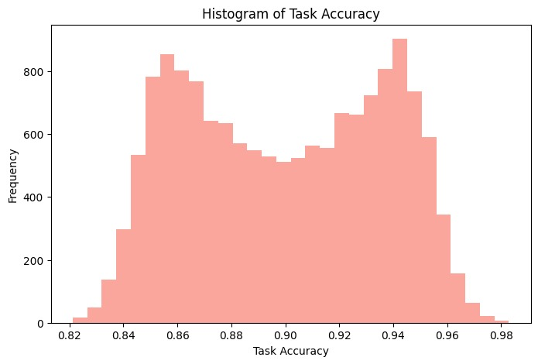
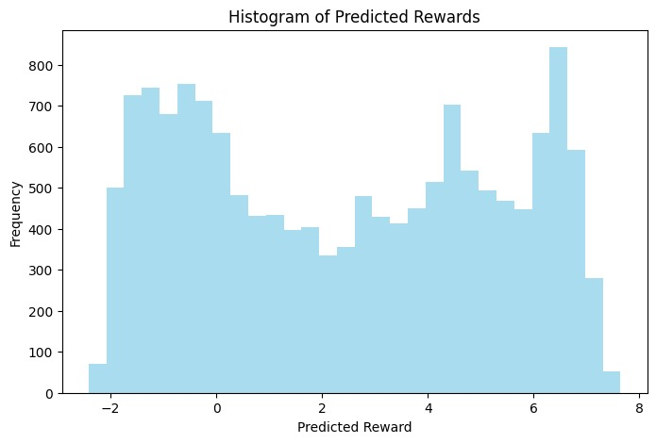
Pipeline Formation
Side-by-side histograms comparing the distribution of the actual task accuracy (left) and the distribution of the DIRL model's predicted rewards (right). The x-axis in the left plot shows task accuracy values, while the x-axis in the right plot shows the learned reward values. The y-axis in both plots represents the frequency of samples.

Slide 23
Implementation

Slide 24
Dataset overview
Captures 3D motion data using 39 anatomical markers placed on key body parts: Head, Torso, Pelvis, Upper Limbs (Left & Right), and Lower Limbs (Left & Right).
Each marker records X, Y, Z coordinates, resulting in 117 total axes (39 markers × 3 dimensions) per time frame.
Detailed marker placement includes specific anatomical points such as shoulders, elbows, wrists, pelvis (ASIS/PSIS), thighs, knees, ankles, heels, toes, and head points (forehead, back of head).
Enables accurate human movement analysis for various applications like biomechanics, gait analysis, pose estimation, and Discriminative Imitation Reinforcement Learning (DIRL).
DIRL-ready dataset structure allows for distinguishing expert vs non-expert movement patterns, supporting reward learning and AI policy training.
24

Slide 25
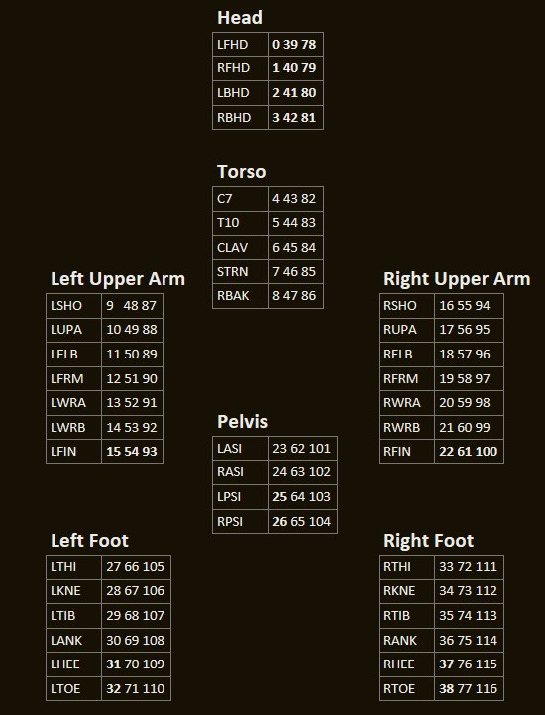
Dataset overview
This table shows the marker names and their corresponding coordinates used for motion tracking in different body parts. These markers help in capturing full-body movement data. Such data is essential for analyzing human coordination in tasks using deep learning models.

Slide 26
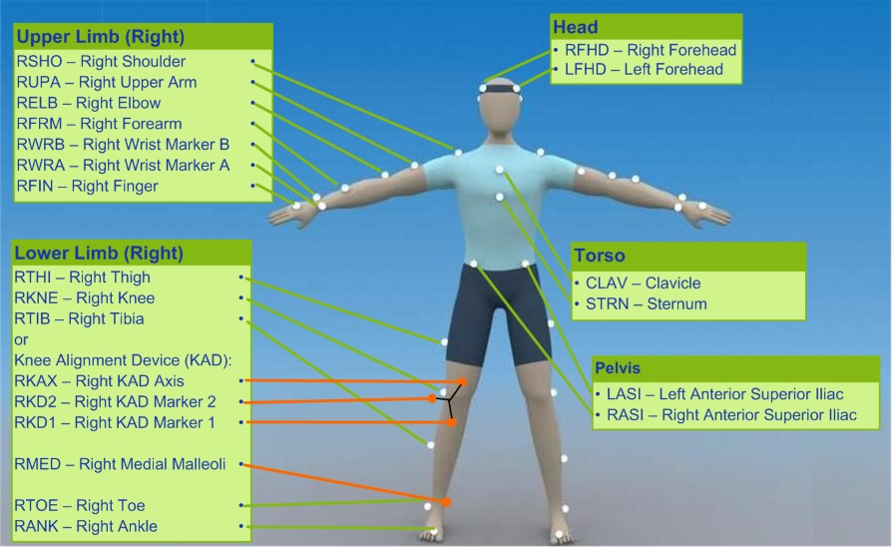
Dataset overview
This image shows the positions of body markers used to track human movement. These markers help in studying how people move and coordinate during tasks. The data is used to understand visuomotor coordination using deep learning methods.

Slide 27
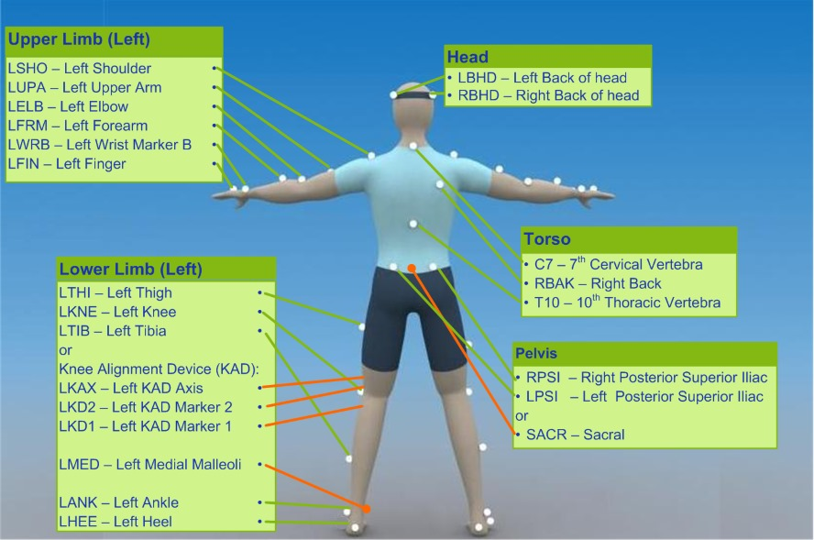
Dataset overview
Markers are placed on different parts of the body to track movement. They include points on the head, torso, arms, legs, and pelvis. These markers help in analyzing body motion accurately. Extra markers are used for better knee alignment tracking.

Slide 28
Implementation Methodology
Data Collection & Preprocessing – Human movement data is captured using the Vicon Plug-in Gait system, preprocessed by filtering noise and normalizing features. Motor demonstrations are recorded to extract optimal dual-task coordination strategies for AI training.
Deep Inverse Reinforcement Learning (DIRL) Implementation – DIRL is used to infer reward functions from expert demonstrations, enabling AI to optimize dual-task performance.
Dual-Task Optimization – The AI model dynamically balances cognitive and motor tasks using adaptive learning mechanisms.
Performance Evaluation – The model’s performance is assessed against human data using gait stability, reaction time, and motor accuracy metrics.

Slide 29
Results

Slide 30
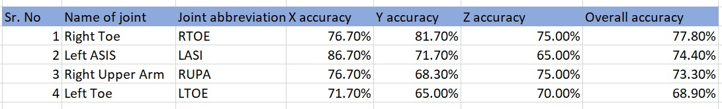
Results : The best and the worst cases
Best-performing case: Right Toe (RTOE) achieved the highest overall accuracy (77.80%), with excellent Y-axis tracking highlighting strong performance in capturing toe-off and foot strike phases.
Strong lateral accuracy: Left ASIS (LASI) showed exceptional X-axis accuracy (86.70%), indicating stable tracking of pelvic motion, although performance declined in the Z-axis.
Challenging upper limb case: Right Upper Arm (RUPA) displayed significant drops in Y-axis accuracy (68.30%), likely due to rapid movements and marker occlusion during dynamic actions like throwing.
Lowest-performing case: Left Toe (LTOE) had the poorest overall accuracy (68.90%), with Y and Z axes showing major inaccuracies.

Slide 31
Results : The best and the worst cases
These insights reinforce the importance of joint-specific analysis and the need for improvements in both marker placement strategies and model robustness for high-speed, dynamic movements.

Slide 32
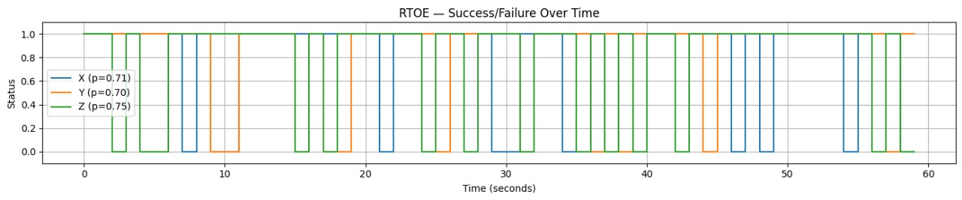
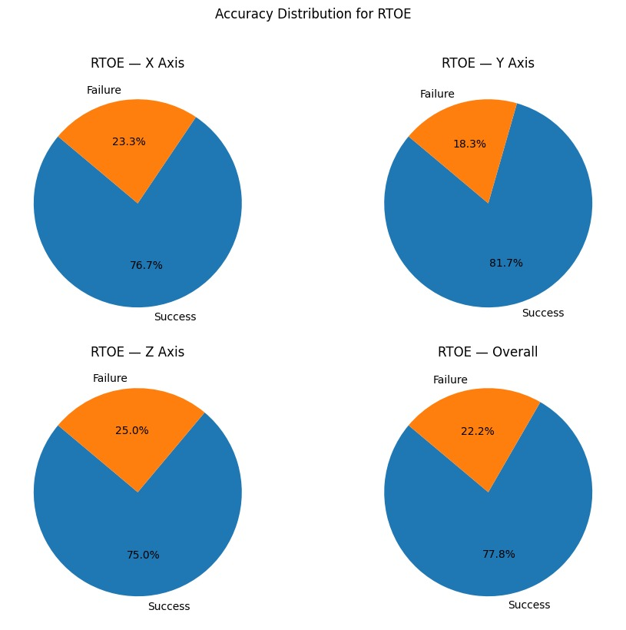
Best Case Predications
Overall accuracy for RTOE is 77.8%, with individual axis accuracies being 76.7% (X axis), 81.7% (Y axis), and 75.0% (Z axis), while failure rates are 22.2% overall, 23.3% (X), 18.3% (Y), and 25.0% (Z).

Slide 33
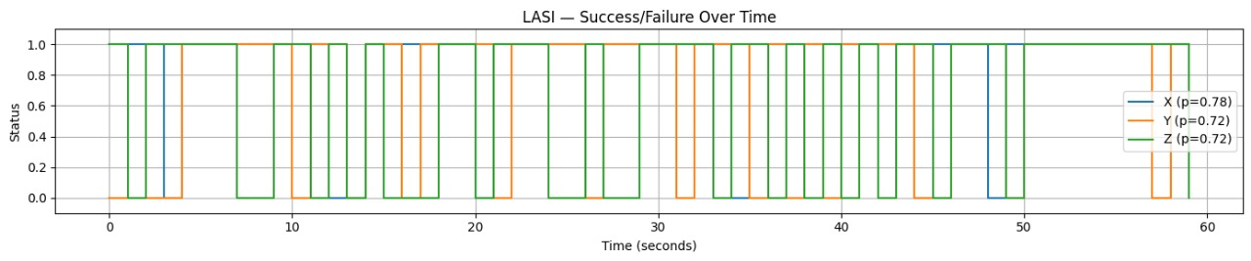
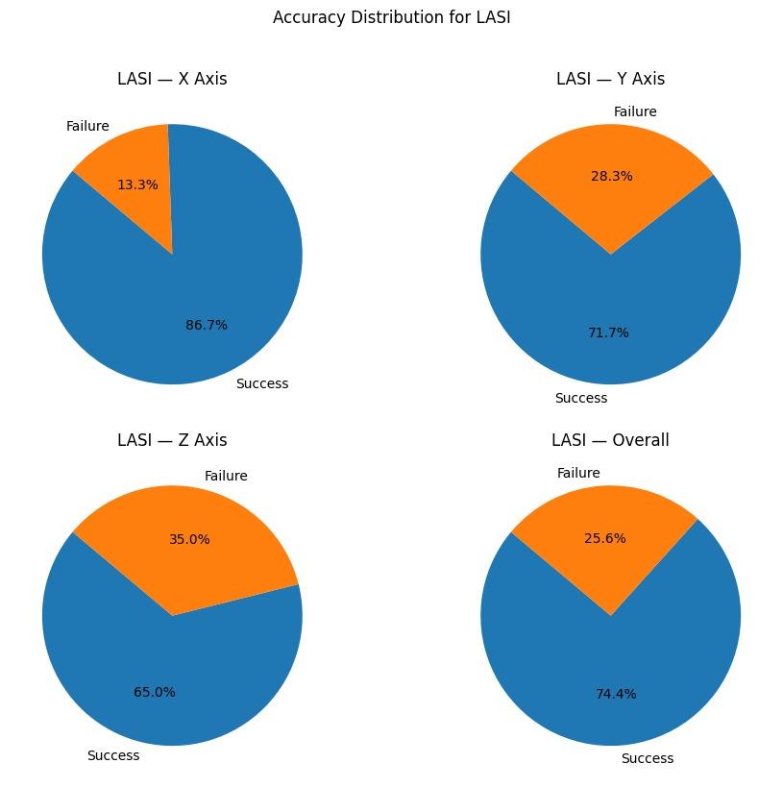
Best Case Predications
Overall accuracy for LASI is 74.4%, with individual axis accuracies being 86.7% (X axis), 71.7% (Y axis), and 65.0% (Z axis), while failure rates are 25.6% overall, 13.3% (X), 28.3% (Y), and 35.0% (Z).

Slide 34
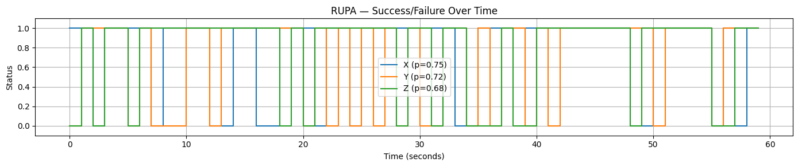
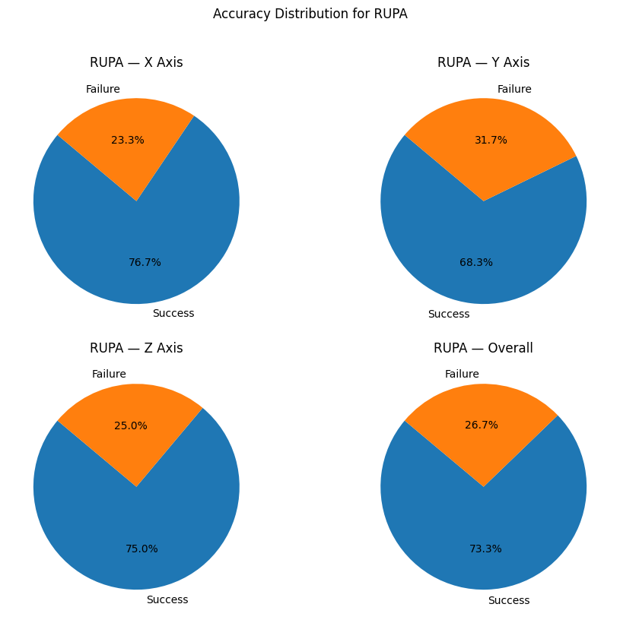
Worst Case Predictions
Overall accuracy for RUPA is 73.7%, with individual axis accuracies being 76.7% (X axis), 68.3% (Y axis), and 75.0% (Z axis), while failure rates are 26.7% overall, 23.3% (X), 31.7% (Y), and 25.0% (Z).

Slide 35
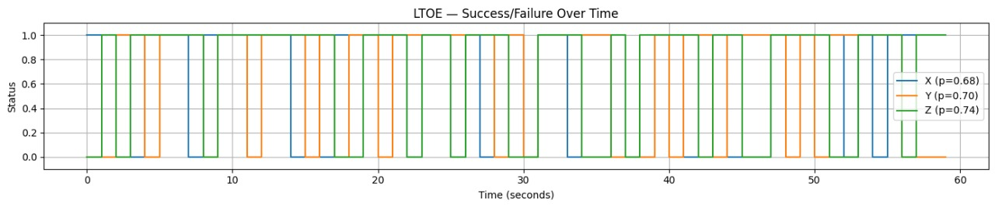
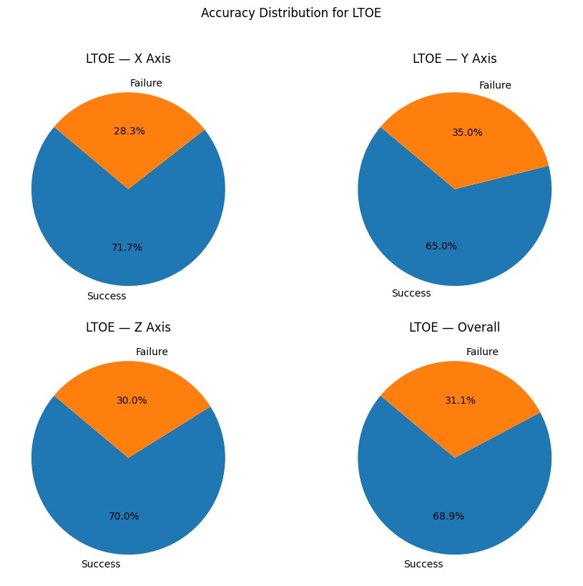
Worst Case Predictions
Overall accuracy for LTOE is 68.9%, with individual axis accuracies being 71.7% (X axis), 65.0% (Y axis), and 70.0% (Z axis), while failure rates are 31.1% overall, 28.3% (X), 35.0% (Y), and 30.0% (Z).

Slide 36
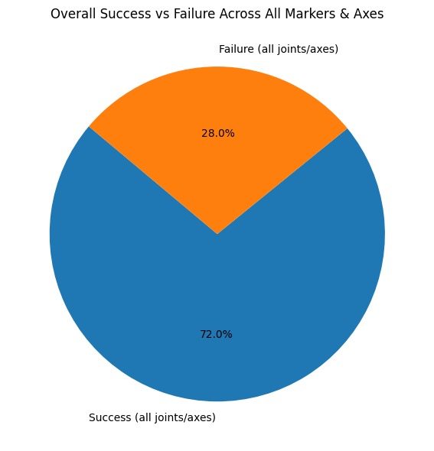
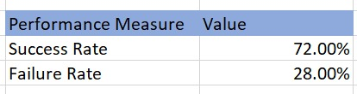
Overall Success Rate
The overall system achieved a 72% success rate and 28% failure rate across all markers and axes, indicating generally reliable performance with some room for improvement in challenging joint/axis conditions, which directly informs DIRL reward modeling and policy optimization.

Slide 37
Conclusion
Overall System Performance
Marker-based motion capture shows 72% mean accuracy
Performs well for core and lower limb movements.
2. Key Limitations Identified
Upper limb tracking fails during high-speed actions like throwing (19% failures)
Foot marker issues in swing phase (9% failures)
Causes: soft tissue artifacts, marker occlusion

Slide 38
Future Scope
We Will be isolating only the throwing along with cases and identify if it improves the accuracy of the DIRL Model.
We will be incorporating a focused biomechanical analysis of significant joints involved in throwing.
We will be also trying to get an in-depth analysis of the learnt weights and biases.

Slide 39
References
Singh, Yogesh, et al. "Dual-motor-task of catching and throwing a ball during overground walking in virtual reality." IEEE Transactions on Neural Systems and Rehabilitation Engineering 28.7 (2020): 1661-1667.
Singh, Yogesh, Sunil K. Agrawal, and Vineet Vashista. "Throwing strategy in a dual-motor-task of aiming at the bullseye while walking in virtual reality." IEEE Robotics and Automation Letters 7.4 (2022): 9091-9098.
Wu, Feiyang, et al. "Infer and adapt: Bipedal locomotion reward learning from demonstrations via inverse reinforcement learning." 2024 IEEE International Conference on Robotics and Automation (ICRA). IEEE, 2024.
Kao, Pei-Chun, and Michaela A. Pierro. "Motor adaptation to cognitive challenges and walking perturbations in healthy young adults." Gait & Posture 92 (2022): 167-175.
Hamilton, F., et al. "Walking and talking: an investigation of cognitive—motor dual tasking in multiple sclerosis." Multiple Sclerosis Journal 15.10 (2009): 1215-1227.

Slide 40
Thank you

